Slide 1
Diabetes prediction system
Mentor Name: Ms.Sarishma
Student Name: Priyanshi

Slide 2

Introduction
Diabetes is a chronic condition affecting millions globally, leading to significant health risks. Early detection is essential for managing the disease and preventing complications.
Machine learning can help predict diabetes by looking at patient data to check their risk. This can help doctors give personalized care and catch the disease early.

Slide 3
Problem Statement
This project explores a machine learning-based approach to diabetes prediction by integrating multiple patient data points (such as age, BMI, blood pressure, etc.) with medical history. The system aims to:
develop a machine learning model that can analyze patient data, such as age, BMI, blood pressure, and other relevant features, to predict the likelihood of a person developing diabetes
to provide a tool for early intervention, helping healthcare professionals identify high-risk individuals and offer personalized recommendations to manage or prevent the disease.

Slide 4
Methodology:
The dataset was loaded and analyzed for missing values and feature correlations using heatmaps.
Features (X) and the target variable (Outcome) were separated. The dataset was split into training and testing sets (80:20 ratio).
Logistic Regression and Random Forest classifiers were trained on the training data to predict diabetes occurrence.
Predictions were made on the test data, and the models were evaluated using accuracy scores to determine performance.

Slide 5
Methodology: Diabetes Prediction Website using Django
Django was used in PyCharm to develop a dynamic web application for diabetes prediction.
HTML templates (home.html and predict.html) were created to design the user interface for data input and displaying results.
In views.py, the Logistic Regression model was integrated directly without pickling. The dataset (diabetes 2.csv) was loaded, preprocessed, and trained in real-time upon user request
User-provided health metrics were collected through a web form and passed to the model for prediction.
The trained model predicted whether the user is Diabetic or Non-Diabetic, and the result was dynamically displayed on the website.

Slide 6
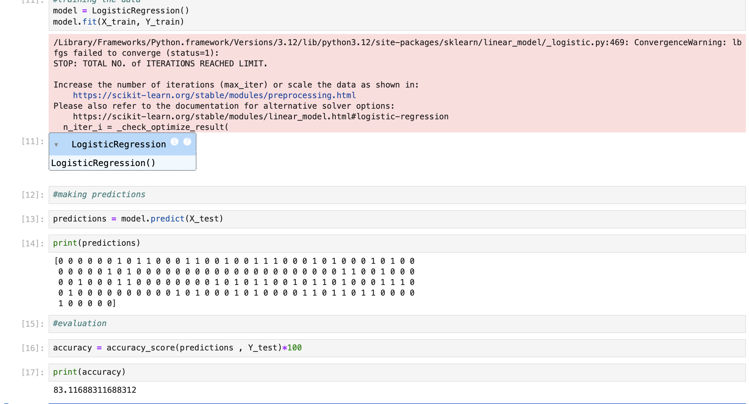
Results:

Slide 7
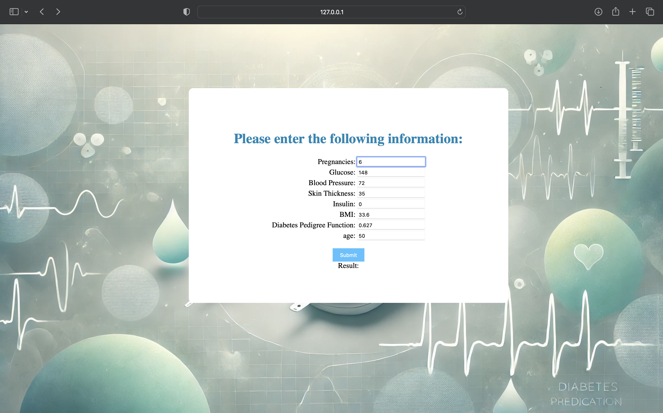
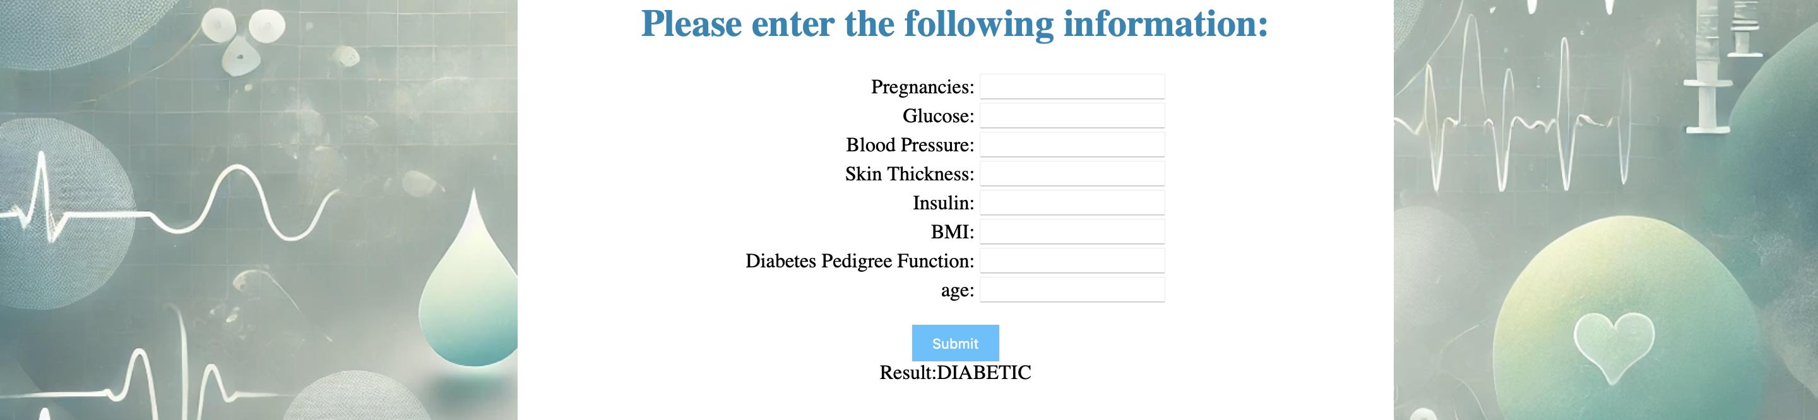
Results:

Slide 8
Conclusion and Future Work
The project successfully predicts diabetes using machine learning, providing accurate and accessible health insights through a web interface.
Future work: Making it on a larger data set and

